Slide 1
Design Principles Behind Design Patterns
Chuck Allison

Slide 2
Objective
Investigate some timeless design principles
Observe how they are manifest in selected design patterns
as well as in other ways
Look briefly at some software patterns that aren’t specifically related to design
Architectural
Organizational

Slide 3
Agenda
The History and Impact of Design Patterns in Software Development
The Anatomy of a Design Pattern
Design Principles
and how they drive pattern creation
Other Types of Patterns

Slide 4
Context
The Design Patterns “movement” has revolutionized software development
Most everyone is familiar with the “Gang of Four” book
Design Patterns: Elements of Reusable Object-oriented Software, Gamma et al
Terms like Strategy and Adapter have crept into our technical vocabularies

Slide 5
The Impact of Design Patterns
They constitute a catalog of reusable software artifacts
They apply in many situations
They share design expertise
They give us a useful, shared vocabulary
“It looks like we need a Composite here”
Most importantly, they improve our thinking about design
Because they adhere to sound principles

Slide 6
23 is not a Magic Number
The 23 GoF design patterns are protypical, but not sacrosanct
There are many more design patterns
New ones still emerge
There are other, non-design software-related patterns
Architectural, organizational, testing, refactoring, process

Slide 7
Strange But True…
The enormous success of design patterns is a testimonial to the commonality seen by object programmers. The success of the book Design Patterns, however, has stifled any diversity in expressing these patterns.
-- Kent Beck

Slide 8
A Quick Pattern History
Developers have long sought a way of preserving and communicating design decisions
The Hillside Group
Smart People found inspiration in Christopher Alexander’s patterns of building architecture
The Timeless Way of Building, 1979
Early publications
Coplien’s Advanced C++, GoF, Coplien’s Software Patterns

Slide 9
Anatomy of a Design Pattern
Summary
State what is trying to be accomplished in succinct, high-level terms
Problem
Describes the context for the problem, the forces that cause the “dilemma”, and the negative consequences of not resolving those forces
Solution
Describes the structure and behavior of the solution. Shows how forces are resolved. Include sketches as needed.

Slide 10
What a Design Pattern Is
A solution to a design problem in a given context
It balances the forces in a given context to achieve a design goal
Design patterns are independent of programming language and platform
They can be manifest in many ways

Slide 11
What a Design Pattern is Not
Just a diagram
sketches help, but different patterns have identical sketches
sketches illustrate forces and their resolution in a general manner
Code
A step-by-step recipe
they’re more of a heuristic
A Panacea

Slide 12
Patterns and Principles
Patterns emerge from principles
“Program to an Interface, not an Implementation”
“Minimize coupling; maximize cohesion”
“Don’t Repeat Yourself”
The principles have long been with us
Long before design patterns were around
It takes effort to master them
Studying and using patterns helps

Slide 13
Design Principles

Slide 14
A Fundamental Principle
Separate things that vary from things that stay the same
The benefit is obvious:
The static part is not affected by changes in other related components
Not always adhered to by developers!
Manifests itself in different ways…

Slide 15
Commonality vs. Variability Take 1 – Designing a Function
The Abstraction: A function encapsulates a group of related operations at the statement level.
What Stays the Same | Coupling Mechanism | What Changes
Procedure Logic | Function Parameters | Input data
int f(int n, string data) {…}

Slide 16
Commonality vs. Variability Take 2 – Designing a Class Hierarchy
The Abstraction: A top-level class defines an interface. Subclasses implement the interface.
What Stays the Same | Coupling Mechanism | What Changes
The Interface | Inheritance, subtype polymorphism | Implementations of individual methods
A related design pattern: Template Method

Slide 17
Template Method
Used in some multi-step algorithms
The top-level, public method calls upon other methods for each step
Some steps don’t vary, some do
The parts that vary are separated out into polymorphic methods
overridden by subclasses
The top-level method is non-polymorphic
it controls the entire process

Slide 18
Template Method Description
Summary
Define the skeleton of an algorithm, deferring some steps to subclasses. Subclasses can customize an algorithm without changing the overall algorithm structure.
Problem
You want to control the steps of the algorithm, but some of the steps vary. You want to factor common behavior among subclasses into the base class to avoid duplication. You want to allow subclasses to customize behavior in a controlled way.
Solution
Provide a fixed interface for clients, but have the implementation call upon hidden, polymorphic methods as needed.

Slide 19
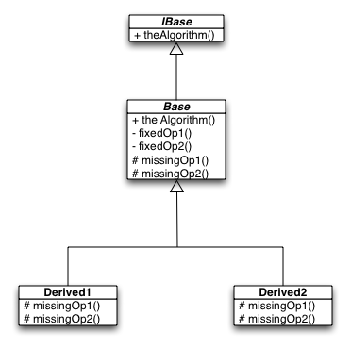
Template Method Class Sketch

Slide 20
Java Code
abstract class Base implements IBase {
public final void theAlgorithm() {
fixedop1();
missingop1();
fixedop2();
missingop2();
}
final void fixedop1() {
System.out.println("fixedop1");
}
final void fixedop2() {
System.out.println("fixedop2");
}
protected abstract void missingop1();
protected abstract void missingop2();
};

Slide 21
Java Code (continued)
class Derived extends Base {
protected void missingop1() {
System.out.println("missingop1");
}
protected void missingop2() {
System.out.println("missingop2");
}
};
class Skeleton {
public static void main(String[] args) {
Derived d = new Derived();
d.theAlgorithm();
}
}

Slide 22
Commonality vs. Variability Take 3 – Designing Families of Implementations
The Abstraction: A client class depends on other classes for part of its behavior. A specific implementation can be selected on demand.
What Stays the Same | Coupling Mechanism | What Changes
High-level Solution Structure | Separate Class Hierarchies | Implementation of solution facets
Related design patterns: Strategy, Bridge, (most…)

Slide 23
Strategy Description
Summary
Define an interchangeable family of algorithms. Let implementations vary independently from clients.
Problem
A client may need variants of an algorithm, configurable at runtime. Without encapsulating the related variants, significant amounts of code must change when an selected implementation changes.
Solution
Define an interface for the family of algorithms. Encapsulate each variant in a subclass. Clients keep polymorphic references to implementations.

Slide 24
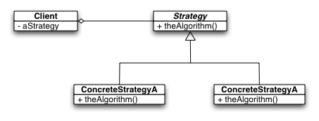
Strategy Class Sketch

Slide 25
Compile-time Applications of Strategy
Isolating platform-specific code
C++ Template Idioms
Traits
Policies
C++ Container Adaptors
All use implicit interfaces

Slide 26
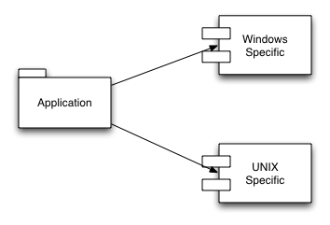
Isolating Platform-Specific Code
Accomplished with conditional compilation, etc.

Slide 27
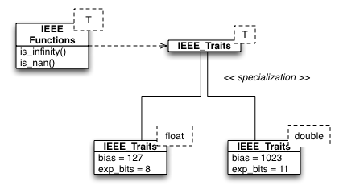
C++ Template Traits
A way of factoring variable data from a template

Slide 28
IEEE Traits
template<typename T>
struct IEEE_traits {};
template<>
struct IEEE_traits<float>
{
typedef float FType;
enum {
nbytes = sizeof(float),
nbits = nbytes*8,
exp_bits = 8,
bias = 127
};
};
template<>
struct IEEE_traits<double>
{
typedef double FType;
enum {
nbytes = sizeof(double),
nbits = nbytes*8,
exp_bits = 11,
bias = 1023
};
};

Slide 29
Using IEEE_Traits
template<typename FType>
bool is_infinity(FType x) {
return exponent(x) == IEEE_traits<FType>::bias+1 &&
fraction(x) == FType(0);
}
template<typename FType>
bool is_nan(FType x) {
return exponent(x) == IEEE_traits<FType>::bias+1 &&
fraction(x) != 0;
}

Slide 30
Policies
Classes with implementation strategies are template arguments
Example – C++ Container Adaptors: queue<int> q1; // Default policy queue<int, list<int> > q2; // Explicit policy

Slide 31
Commonality vs. Variability Take 4 – Designing User Interfaces
The Abstraction: Data can be presented to users in different ways. Views vary independently of data.
What Stays the Same | Coupling Mechanism | What Changes
The data (structure of model) | Complex! (MVC) | The current user view
Related design patterns: Model-View-Controller (Observer + Composite + Strategy)

Slide 32
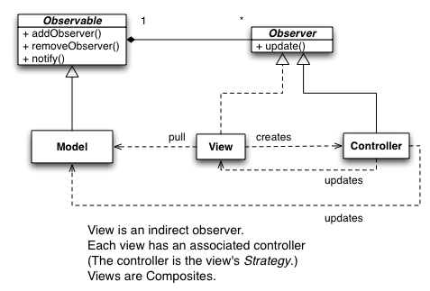
Model-View-Controller

Slide 33
Another Fundamental Principle
Program to an Interface, not an Implementation
Same benefit as before (shield clients from changes)
Actually, just a special case of the previous principle
interfaces stay the same, implementations vary
You can’t program exclusively to an interface unless it exists separately from the implementation
Moral: Many design principles “overlap”

Slide 34
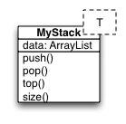
OOP 101
Design a Stack Class

Slide 35
MyStack in Java
class MyStack<T> {
private ArrayList<T> data = new ArrayList<T>();
public void push(T t) {
data.add(t);
}
public T pop() {
return data.remove(data.size()-1);
}
public T top() {
return data.get(data.size()-1);
}
public int size() {
return data.size();
}
}

Slide 36
Using MyStack
public static void main(String[] args {
MyStack<Integer> stk = new MyStack<Integer>();
stk.push(1);
stk.push(2);
System.out.println(stk.size()); // 2
System.out.println(stk.pop()); // 2
System.out.println(stk.pop()); // 1
System.out.println(stk.size()); // 0
}

Slide 37
How is Our Design?
Is the user really shielded from changes in implementation?
No…
The fact that we use an ArrayList introduces a dependency for the user
If we change it later, the user is affected
Or a better class with a different name may come along
Users should program to an interface

Slide 38
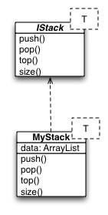
Separate The Implementation

Slide 39
Using IStack
static void test(IStack stk) { // Transparency
stk.push(1);
stk.push(2);
System.out.println(stk.size());
System.out.println(stk.pop());
System.out.println(stk.pop());
System.out.println(stk.size());
}
public static void main(String[] args) {
IStack<Integer> stk = new MyStack<Integer>();
test(stk);
}

Slide 40
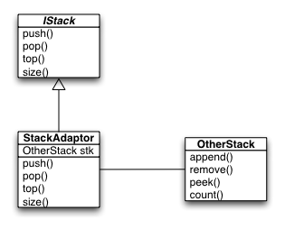
Using a Different Implementation
Programming to an interface facilitates adapting to a different implementation
The Adapter Pattern:

Slide 41
A Variation on Adaptor
The essence of Adapter allows clients to use a familiar interface with an implementation with a different interface
The interfaces can be implicit
Example: C++ function-object adapters

Slide 42
C++ Function Object Adapters
bind1st, bind2nd:
convert a binary function into a unary function by saving one of the arguments
not1, not2:
logically negate the return value of a function
Among others

Slide 43
Using bind2nd and not1
int main() {
// Add 5 to some integers
int a[] = {10, 25, 40};
transform(a, a+3, a, bind2nd(minus<int>(), 5));
copy(a, a+3, ostream_iterator<int>(cout, " "));
cout << endl; // Printed: 5 20 35
// See if the result is even or not
bool b[3];
transform(a,a+3,b,not1(bind2nd(modulus<int>(),2)));
cout << boolalpha; // Print "true" instead of "1"
copy(b, b+3, ostream_iterator<bool>(cout, " "));
cout << endl; // false true false
}

Slide 44
A Related Principle
Separate object creation from object use
Client contexts can then use such objects polymorphically
by programming to an interface only
Isolating object creation into a single module is Good Design

Slide 45
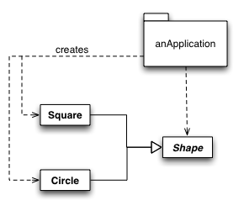
Violating the Principles

Slide 46
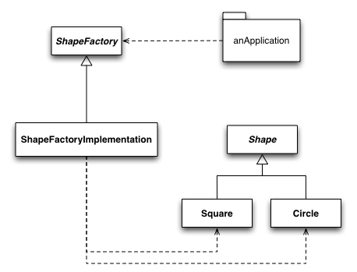
A Better Approach

Slide 47
Factory Method Description
Summary:
Lets a class defer object instantiation to concrete classes polymorphically.
Problem:
A module uses an abstraction, so you want to follow the DIP and not depend on concrete details. Client modules shouldn’t need to know which concrete class to instantiate.
Solution:
Define an interface for creating a family of objects, but let concrete subclasses decide which class to instantiate.

Slide 48
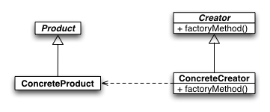
Factory Method Sketch
// Client has been given a Creator object
Product aProduct = aCreator.factoryMethod();

Slide 49
Opposing Forces
Objects are most easily created with a new expression, using the concrete class
But this introduces a dependency on a concrete class, losing the flexibility of “programming to an interface, not an implementation”
and also losing the flexibility of separating object use from object creation
the using module may not have all the details needed for creation

Slide 50
Balancing the Forces
Factory Method balances these forces by encapsulating object creation
Users call a method that “does the right thing”
But one size does not fit all…

Slide 51
Variations On Factory Method
Plain Factory Method
just a function
no need for inheritance
Class Factory Method
Clone Method
an “Object Factory Method”

Slide 52
Plain Factory Method
// Separate creator class
final class Creator {
public static Product create() {
return new Product();
}
}
// Non-polymorphic:
class Product {
// Non-public constructor
Product(){/* whatever */}
}

Slide 53
Class Factory Method
The class is the creator
The factory method is static
Example:
valueOf methods: Integer n = Integer.valueOf(s);

Slide 54
Clone Method
An object is the creator
The factory method is therefore non-static
Example:
standard clone( ) overrides: Foo f2 = f.clone();

Slide 55
Another Perspective
Dependency Inversion Principle
High-level components should not depend (“know about”) lower-level components
that’s why client modules should not explicitly create concrete objects
All components should depend on abstractions as much as possible

Slide 56
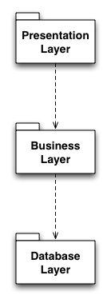
Violating the Principle
Classic
3-tier
Architecture

Slide 57
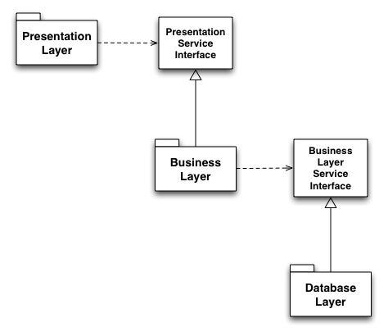
A Better Design

Slide 58
Dependency Rules of Thumb “Little Principles”
No variable in an abstraction should hold an explicit pointer to a concrete class
Use top-level pointers polymorphically
No class should derive from a concrete class
Only derive from abstract classes
No method should override an implemented method of any of its base classes
Only override abstract methods
These rules can’t be followed all the time!
The key is: How volatile is the lower-level module?

Slide 59
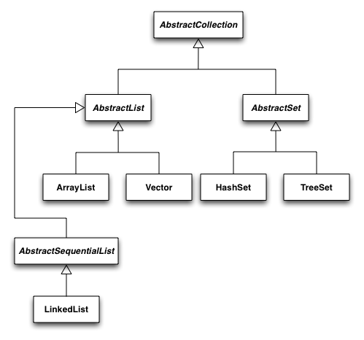
Java 2.0 Collections

Slide 60
Resource Management
Factory Method is about initialization
resources other than memory can be allocated
How do you ensure resource deallocation?

Slide 61
Disposal Method
Encapsulates the details of object disposal by providing an explicit method for cleanup
Disposal Method complements Factory Method by resolving issues Factory Method leaves dangling
Two Variations:
Factory Disposal Method
Self-Disposal Method

Slide 62
Factory Disposal Method
final class Creator {
public static Product create() {
return new Product();
}
public static void dispose(Product p) {
/* whatever */
}
}
…
Creator::dispose(p);

Slide 63
Self-Disposal Method
final class Creator {
public static Product create() {
return new Product();
}
public void dispose() {
/* whatever */
}
}
…
p.dispose();

Slide 64
C++ Variation
Deterministic destruction can automate resource deallocation:
constructors allocate a resource
destructors deallocate the resource
Destructors execute automatically
RAII Idiom
“Resource Acquisition Is Initialization”
Similar functionality in C# via using

Slide 65
RAII in C++
{
ifstream f("myfile");
string line;
while (getline(f,line))
cout << line << endl;
} // stream closes automatically

Slide 66
Using C++0x’s shared_ptr
class Foo {
public:
Foo(){}
~Foo() {
cout << "destroying a Foo\n";
}
};
int main() {
vector<shared_ptr<Foo> > v;
v.push_back(shared_ptr<Foo>(new Foo));
v.push_back(shared_ptr<Foo>(new Foo));
v.push_back(shared_ptr<Foo>(new Foo));
}

Slide 67
Using a Custom Deleter
int main() {
FILE* f2 = fopen("deleter.cpp", "r");
shared_ptr<FILE> theFile(f2, &fclose);
/* … */
}

Slide 68
Multi-Step Resource Management
Composite resources usually need to be handled as transactions
if an exception occurs at any time during allocation, previously competed allocation need to be backed out
Gnarly with try-blocks
see next slide

Slide 69
void g() { // 3-part transaction
risky_op1();
try {
risky_op2();
}
catch (Exception x) {
undo_risky_op1();
throw x; // Rethrow exception
}
try {
risky_op3();
writeln("f succeeded");
}
catch (Exception x) {
undo_risky_op2();
undo_risky_op1();
throw x;
}
}

Slide 70
Scope Guards in D
void g() {
risky_op1();
scope(failure) undo_risky_op1();
risky_op2();
scope(failure) undo_risky_op2();
risky_op3();
writeln("g succeeded");
}

Slide 71
Extending a Class
Typically done via inheritance
an example of code reuse
Comes with a price:
dependency on a concrete class
inheritance is a compile-time mechanism
adding functionality statically can lead to class explosion
you may want runtime extension

Slide 72
OO Design 101 Redux
Consider a GUI type named Window
Unadorned, but functional
Now suppose we want some more full-featured windows
Bordered, scrollable, etc.
How do we design this?

Slide 73
OO Design 101 Redux
A BorderedWindow is most assuredly a Window
Certainly sounds like an “is-a”
Ditto ScrollableWindow
Sort of obvious, right?
Let’s see…

Slide 74
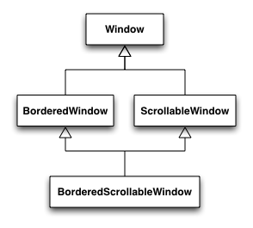
A “Simple” Window Hierarchy

Slide 75
Counting Classes
Note that the number of classes is quite predictable:
1 (= C(2,0)) for the root
2 (= C(2,1)) for the single-featured subclasses
2 features total, choosing 1 at a time
1 (=C(2,2)) for the leaf
Combines all features
Total of 4

Slide 76
Evaluating Our Design
Ignore details of multiple inheritance…
We can always work around that
Any other problems?

Slide 77
Problem #1
The subclasses have operations that the Window superclass doesn’t
scroll, for example
Not completely an “is-a”
But it isn’t terribly unusual for a subclass to add operations; no biggie
We could put these methods in Window
But they’d be no-ops in the subclasses that don’t use them
Someone isn’t encapsulating variation!

Slide 78
Problem #2
What if we need to add another important, independent windowing feature?
WhizbangWindow
What impact does this have on the hierarchy?

Slide 79
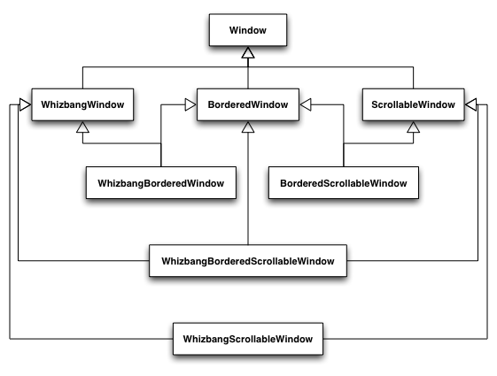
Hierarchical “Progress”

Slide 80
Definitely Counting Classes
1 (= C(3,0)) for the root
3 (= C(3,1)) for the first row
Single-featured
3 (= C(3,2)) for the second “row”
Double-featured
1 (= C(3,3)) for the leaf
All three
Total of 8

Slide 81
Looking Ahead
C(n,0) + C(n,n-1) + … + C(n,1) + C(n,0)
Equals 2^{n}
Can anyone say “combinatorial explosion”?

Slide 82
The Open-Closed Principle
Classes should be open for extension, but closed to modification
In other words, you should be able to add to or modify a class’s functionality without changing its code
Otherwise users depend on volatile code
How?

Slide 83
The Decorator Pattern
Uses composition in place of inheritance
A decorator wraps an object polymorphically
It adds or modifies functionality
calling back to the original object as needed
Decorators can be created and combined at runtime

Slide 84
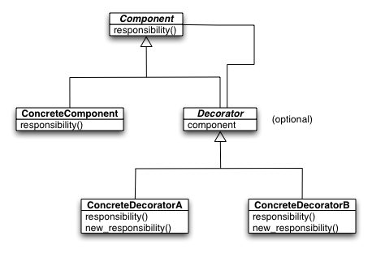
Decorator Class Sketch

Slide 85

Decorator Object Sketch
Decorator objects ultimately call back to an original concrete component. They can be used to implement before-after-around methods. They can be composed at runtime.

Slide 86
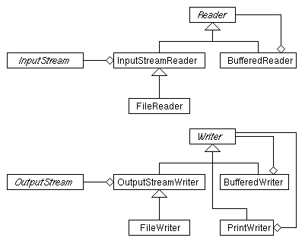
Decorator in java.io

Slide 87
A Companion Principle
Prefer Composition to Inheritance
More flexible
Often simpler
Inheritance is for static, “is-a” relationships

Slide 88
C++ Example
From class homework

Slide 89
Coupling
Another way to express these ideas is the old adage: Minimize coupling between related entities
Or to paraphrase Einstein: Objects that interact should have as little coupling as possible, but no less
Finding that coupling “sweet spot” takes a little finesse
and some abstractions :-)

Slide 90
(Observer)

Slide 91
(Near the end)
shu-ha-ri

Slide 92
Bibliography
Bertrand Meyer
Agile Software Development
Head-First Design Patterns
Factory and Disposal Methods, Kevlin Henny

